Slide 1

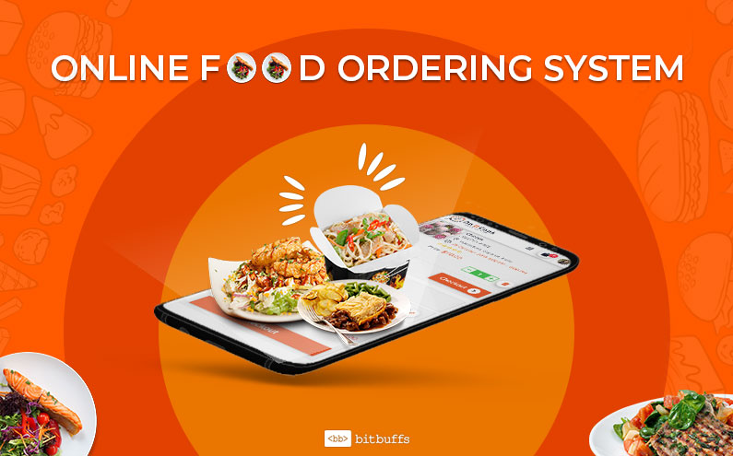

ONLINE FOOD ORDERING SYSTEM
Members
Silvia mueni dit-01-1374/2019
Peris wanyoike dit-01-1323/2019
Kelvin munene dit-01-1303/2019
Jecinta ithagi dit-10-1328/2019

Slide 2
Problems solved
When it comes to issues in delivery not only is delays included but also the quality and quantity of the food.
Reduces manual listing of orders by the waiters/waitress which may result to slow response in customer service.

Slide 3
Objectives
To develop a system whereby the admin can control food orders in the restaurant.
To develop a system that will satisfy the customers.
To design a system able to accommodate huge amount of orders at a time.
To improve the communication between the client and the server and minimize the time of ordering.

Slide 4
Scope
The system will provide a security module which will have three levels of access such as ;admin , hotel , user.
The system view a notification that the order has been received based on the requirement of the system.
The system will have database that stores all the order information of the customers

Slide 5
limitation
Deliverymen put themselves in danger during harsh weather conditions.
Conflict between restaurants and delivery providers regarding payments.
Health issues since one is not sure of what ingredients used or how clean the restaurant is.

Slide 6
Recommendations
Based on user feedback the following areas of improvement were indentified;
Add numerous payment methods to give customers many choices i.e. ; use of m pesa , visa card.
Allow customers to checkout as guests to avoid signing up.
Coming up with new marketing materials and promotion.

